Slide 1
Open Data Working Group: Showcases from agricultural domain
Giannis Stoitsis, Agro-Know Technologies
Open Data Working Group Meeting, National Documentation Center, 18/10/2013

Slide 2
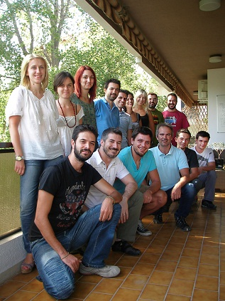
Agro-Know Technologies
Transform agricultural and biodiversity data into services
Develop meaningful services using biodiversity and agricultural data

Slide 3
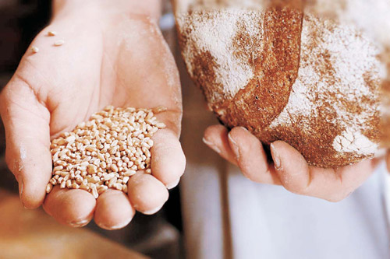
Our values
use open data to solve meaningful societal challenges
create a data-powered ecosystem that may bootstrap agricultural & food innovation
embrace all data sources, formats & types relevant to agricultural research & innovation
be technology agnostic
be vendor independent
promote open source and open data

Slide 4
Relevant activities
Participation in the data interoperability groups of the Research Data Alliance
wheat
germplasm
G8 for Open Data in Agriculture
EU projects for the generation of a linked agricultural data infrastructure
agINFRA
SemaGrow
Notes:
At the 2012 G-8 Summit, G-8 leaders committed to the New Alliance for Food Security and Nutrition, the next phase of a shared commitment to achieving global food security.
As part of this commitment, they agreed to “share relevant agricultural data available from G-8 countries with African partners and convene an international conference on Open Data for Agriculture, to develop options for the establishment of a global platform to make reliable agricultural and related information available to African farmers, researchers and policymakers, taking into account existing agricultural data systems.”

Slide 5
Open data in Agriculture

Slide 6
Agriculture is about to experience a “growth shock” in order to cover the exponentially increasing food needs of the global population
Key facts about agricultural trends
All demographic and food demand projections suggest that, by 2050, the planet will face severe food crises due to our inability to meet agricultural demand – by 2050:
9.3 billion global population, 34% higher than today
70% of the world’s population will be urban, compared to 49% today
food production (net of food used for biofuels) must increase by 70%
According to these projections, and in order to achieve the forecasted food levels by 2050, a total investment of USD 83 billion per annum will be required
A large part of this investment will need to be focused on R&D

Slide 7
One of the most promising routes to agriculture modernisation is the provision of Open Data to all interested parties
Open Data in Agriculture
In an era of Big Data, one of the most promising routes to achieve R&D excellence in agriculture is Open Data, and in particular:
provisioning,
maintaining,
enriching with relevant metadata and
making openly available a vast amount of open agricultural data
The use and wide dissemination of these data sets is strongly advocated by a number of global and national policy makers such as:
The New Alliance for Food Security and Nutrition G-8 initiative
FAO of the UN
DEFRA & DFID in UK
USDA & USAID in the US

Slide 8
Open data is not always that useful ….
Messy data
Should be collected/fused
Should be filtered
Should be validated
Should be enriched with metadata to become discoverable
Should be standardized to allow interoperability

Slide 9
data sources

Slide 10
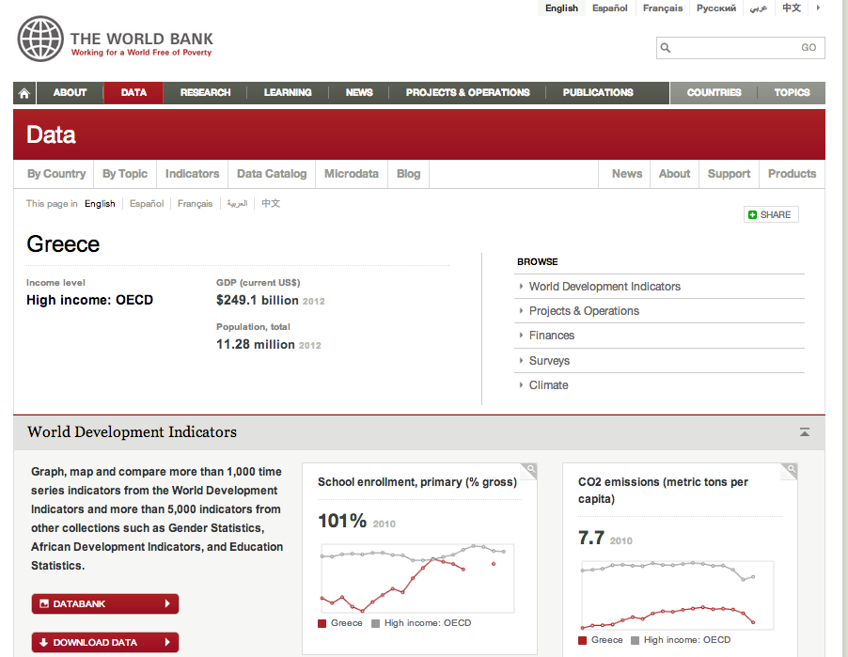
Data sources
Notes:
Statistical Service (http://www.mof.gov.cy/mof/cystat/statistics.nsf/agriculture_51main_gr/agriculture_51main_gr?OpenForm&sub=1&sel=2)

Slide 11
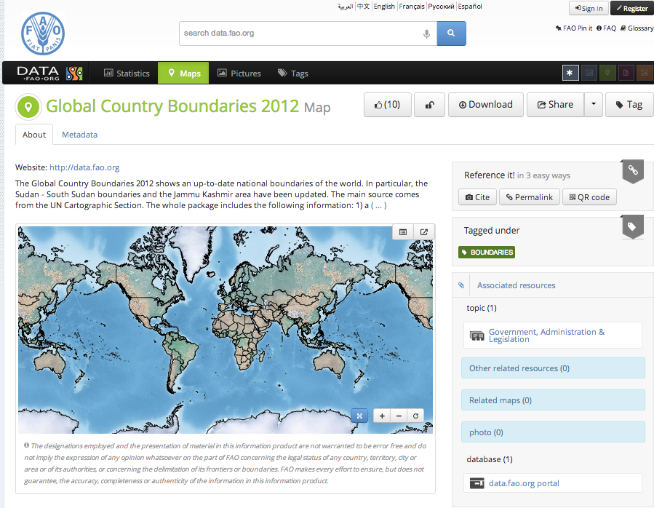
Notes:
Statistical Service (http://www.mof.gov.cy/mof/cystat/statistics.nsf/agriculture_51main_gr/agriculture_51main_gr?OpenForm&sub=1&sel=2)

Slide 12
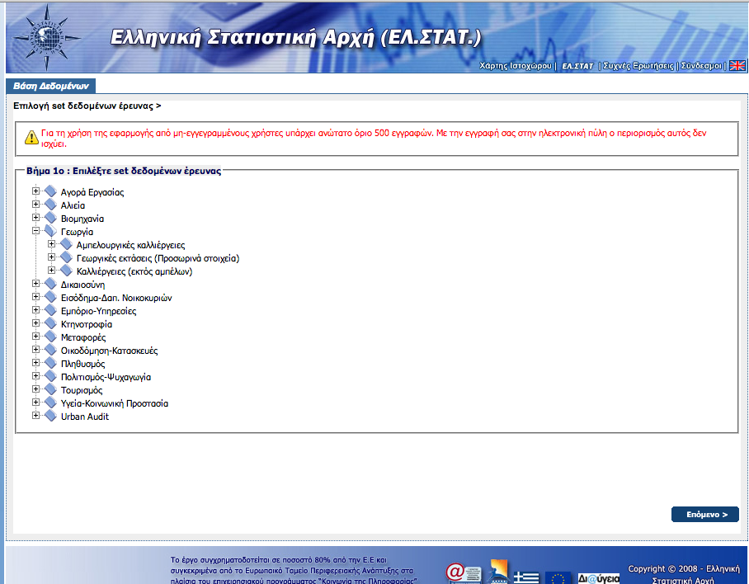
Data sources
Notes:
Statistical Service (http://www.mof.gov.cy/mof/cystat/statistics.nsf/agriculture_51main_gr/agriculture_51main_gr?OpenForm&sub=1&sel=2)

Slide 13
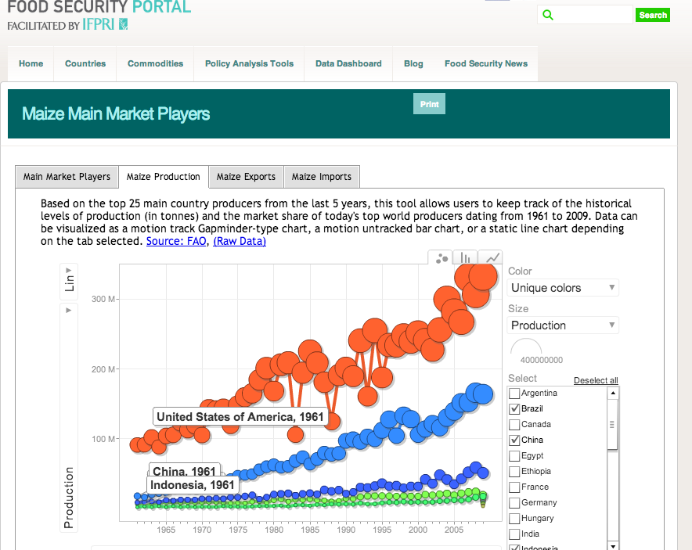
Notes:
Statistical Service (http://www.mof.gov.cy/mof/cystat/statistics.nsf/agriculture_51main_gr/agriculture_51main_gr?OpenForm&sub=1&sel=2)

Slide 14
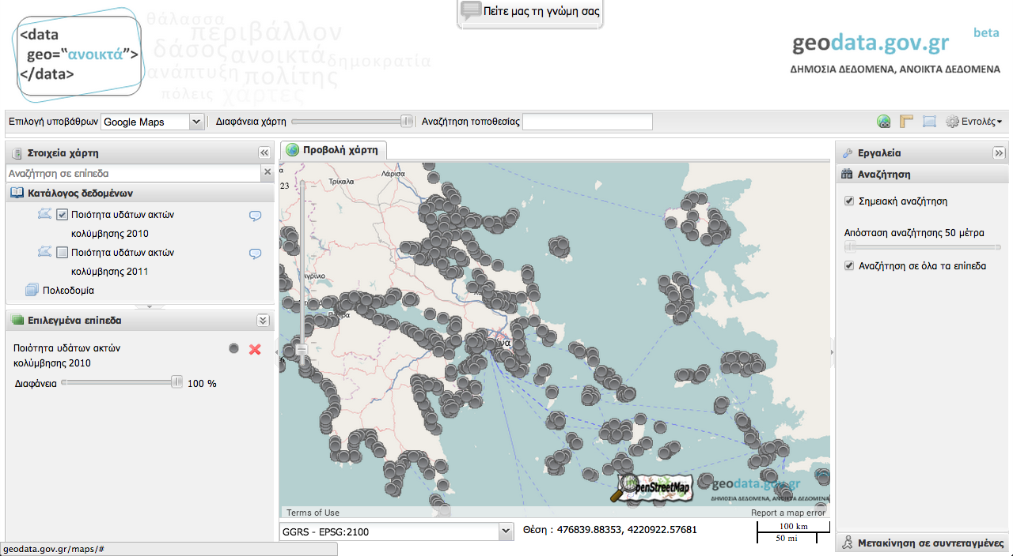

Slide 15
showcases

Slide 16
Main goal
to show how open data can
support decision making in agricultural domain
increase productivity
contribute to food safety

Slide 17
Why open data in agriculture
Decision makers need answers to questions such as
where to set up a unit?
which agricultural activities to support through funding?
which type of cultivations?
new investments

Slide 18
case of agro-food cooperatives

Slide 19
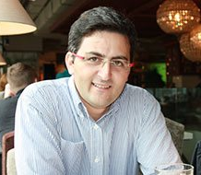
Let’s meet a persona
Christos Stamatis
CEO of the Stevia Coop
Crowd funding model
250 growers
first Greek Stevia
Problems that the coop is facing
How to follow food standards
Where to create value added processing unit
How much to invest in organic production
Price for the product

Slide 20
Problem 1: Strengthen the knowledge about food safety
The coop needs to strengthen the knowledge in Food Safety and to follow the standards
Needs to have access to a portal that provides access to such information
It could be extended to cover also other food products and domains
What kind of open data are needed
OER from Educational Institutions
Open courses
Data from the ministry on which are the food standards
Data from FAO e.g. FAO codex

Slide 21
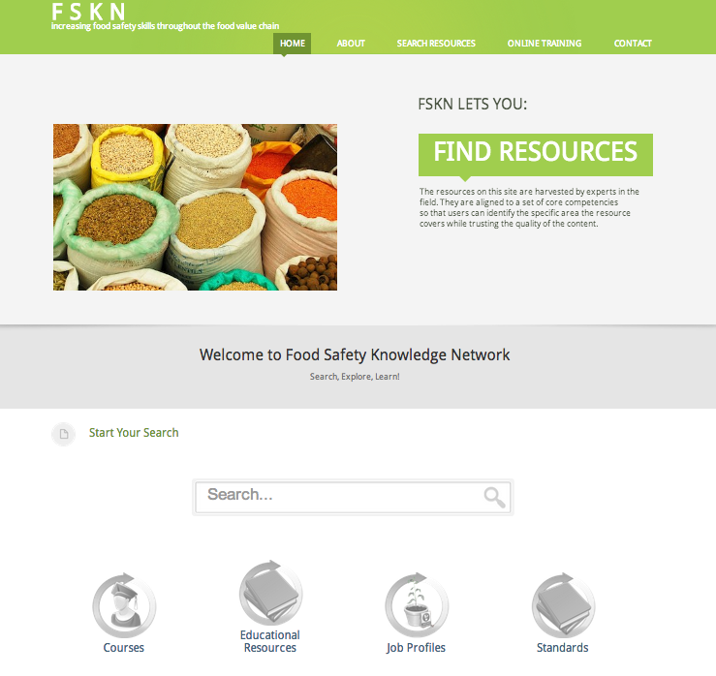
Problem 1: Example
Food Safety Knowledge Network
find trusted high quality content (OER and standards) regarding food safety
find job profiles and connected competences

Slide 22
How such service can help
Benefits for a stakeholder
personnel that you need to ensure that you will follow the food safety standards
find the food safety standards that should be followed
define relevant training for your employees

Slide 23
Problem 2: Where to set up the adding value processing unit
The cooperative would like to have a product on the shelf
Valuable information
available energy resources
shipping roots
availability of land

Slide 24
Problem 3: Organic portion of the coops cultivation
A cooperative would like to invest more in organic cultivation
Valuable information
market needs in organic products and stevia specifically
prices of the last years for conventional products
climate conditions
soil quality maps

Slide 25
Problem 4: Define product price
Estimate the price for coops’ product
Valuable information
sugar prices
international prices of stevia
meteo data
import prices in Greece

Slide 26
case of hellenic ministry of rural development and Food

Slide 27
Problem: Design of a state aid for a new cultivation
Decision makers of the Greek Ministry of Agriculture
Should the ministry of Agriculture invest in a new cultivation like Stevia?
Which open data
Maps with irrigation info
Maps with land use
World statistics about the prices of stevia during the last 5 years
Data about the number of agricultural equipment in Greece that could be re-used
Info about imports in stevia
Info about imports in sugar
Meteo data
Decision support tools

Slide 28
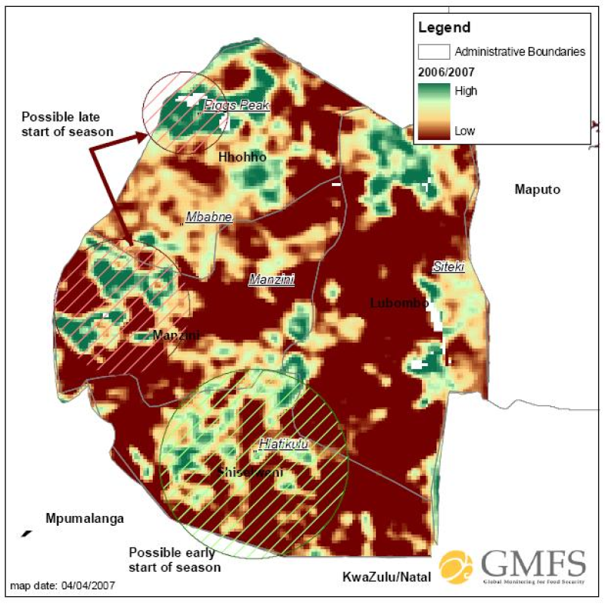
Potential production map example

Slide 29
What this needs
climate conditions and forecasts
agricultural land map
irrigation map
soil quality map

Slide 30
ideas about the demo

Slide 31
Open Data Working Group Agricultural Showcase
Focus on the Food Safety case
Aggregate all open educational resources at a national and international level
convince national organizations to open their educational data and especially metadata
Aggregate all job profiles at a national and international level
Combine with other datasets e.g. education, maps etc

Slide 32
A food safety knowledge gateway for cooperatives and agro food SMEs
Similar to Food Knowledge Safety Network
Cover at least 2 cases e.g. stevia, peach
Find the data for each
Learning resources and courses
Job profiles
Competences
Technology
tool for manual indexing
tool for the aggregation of metadata
simple portal build in Drupal

Slide 33
Action plan
Select the showcase
Finalize the showcase
Create a demo at a small scale
Present the demo at the next open data event

