Slide 1
Open Data Working Group: Showcases from agricultural domain
Giannis Stoitsis, Agro-Know Technologies
Open Data Working Group Meeting, MTSR, 20/11/2013

Slide 2
Icons

Slide 3
Agricultural Showcase Concept
High level pitch:
Open data powered iGoogle for agricultural
Not single mash up but interactive approach e.g. user can enter a query term, he can expand queries etc.
Trusted sources
Cases
Stevia Coop
Venus Coop
Public bodies?

Slide 4
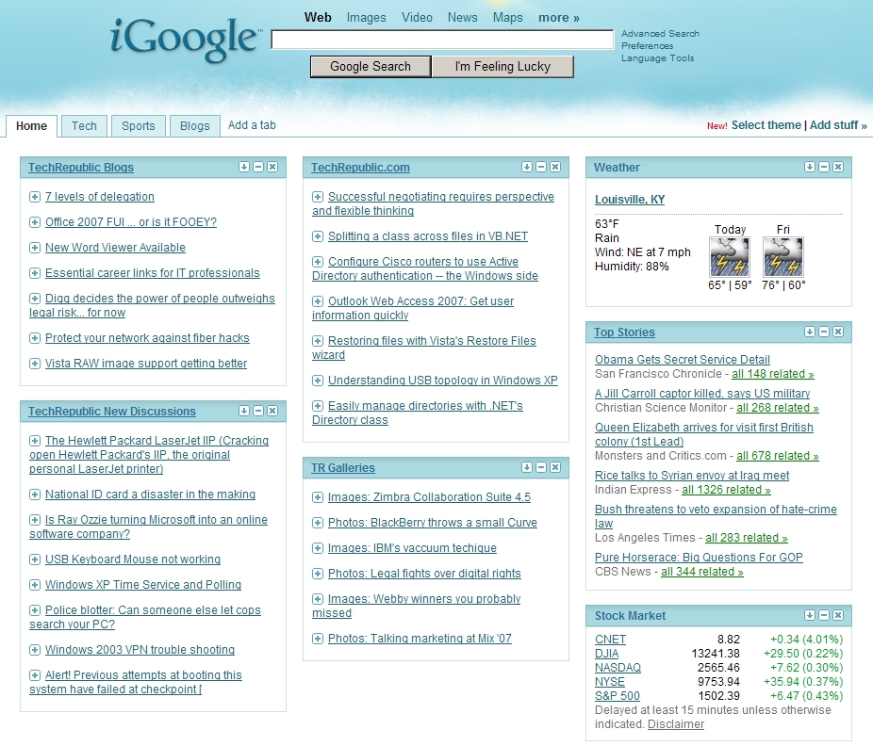
How it can look like?
Export/Import news
Climate change
Pests info
Research achievements
Seed/Varieties/Genetic
New fertilizers
Weather info and forecasts for local area
….

Slide 5
data sources To start with

Slide 6
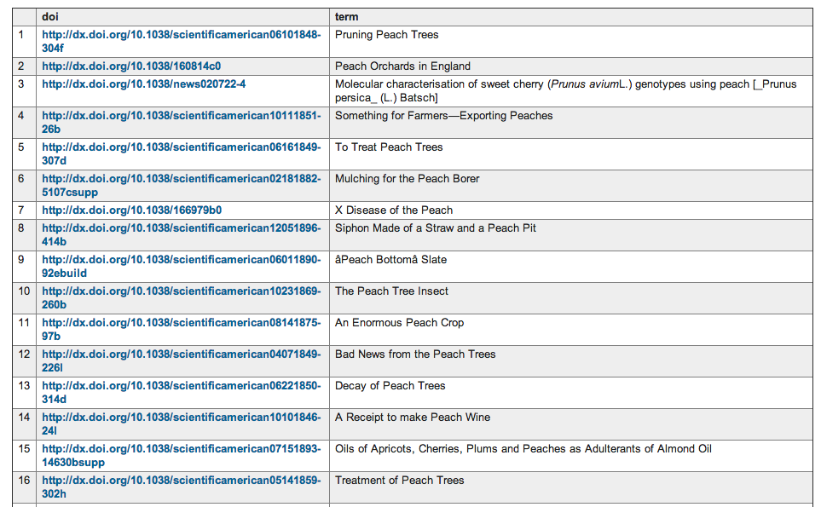
Publications

Slide 7
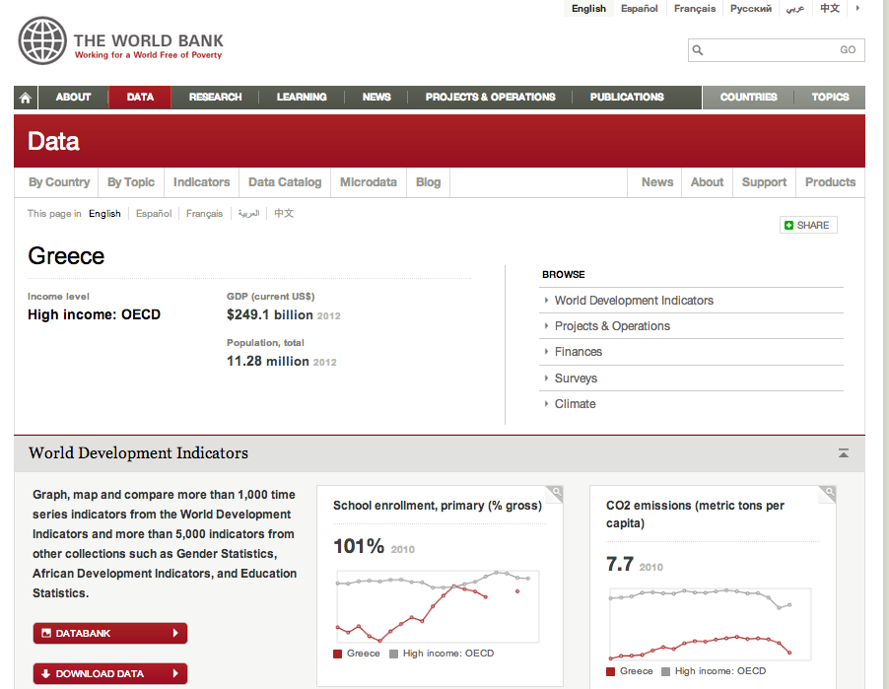
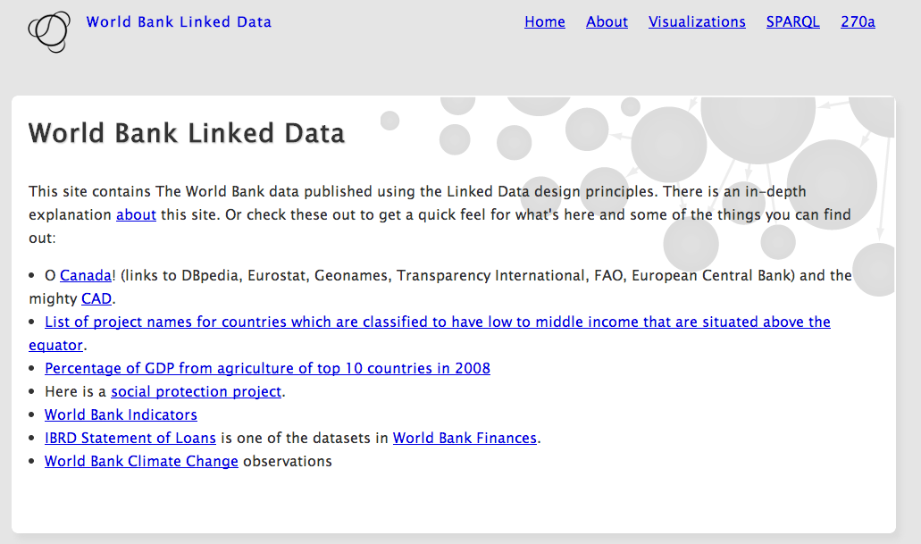
Demographic and financial
Notes:
Statistical Service (http://www.mof.gov.cy/mof/cystat/statistics.nsf/agriculture_51main_gr/agriculture_51main_gr?OpenForm&sub=1&sel=2)

Slide 8
Statistical and Maps
Notes:
Statistical Service (http://www.mof.gov.cy/mof/cystat/statistics.nsf/agriculture_51main_gr/agriculture_51main_gr?OpenForm&sub=1&sel=2)

Slide 9
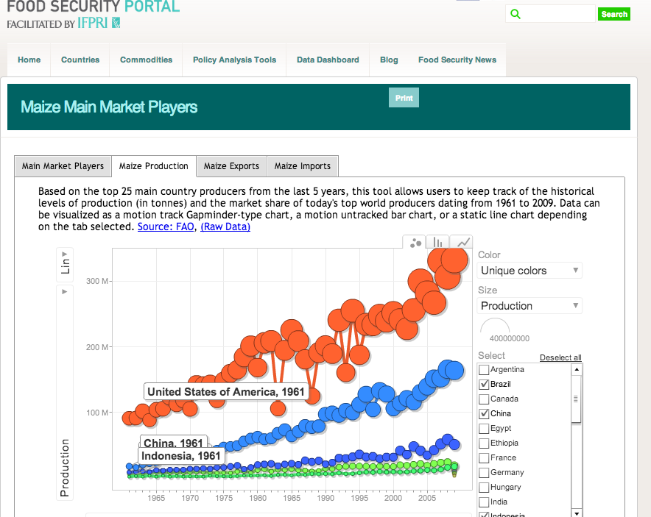
Food Safety
http://data.ifpri.org/sparql
Notes:
Statistical Service (http://www.mof.gov.cy/mof/cystat/statistics.nsf/agriculture_51main_gr/agriculture_51main_gr?OpenForm&sub=1&sel=2)

Slide 10
data sources and continue with

Slide 11
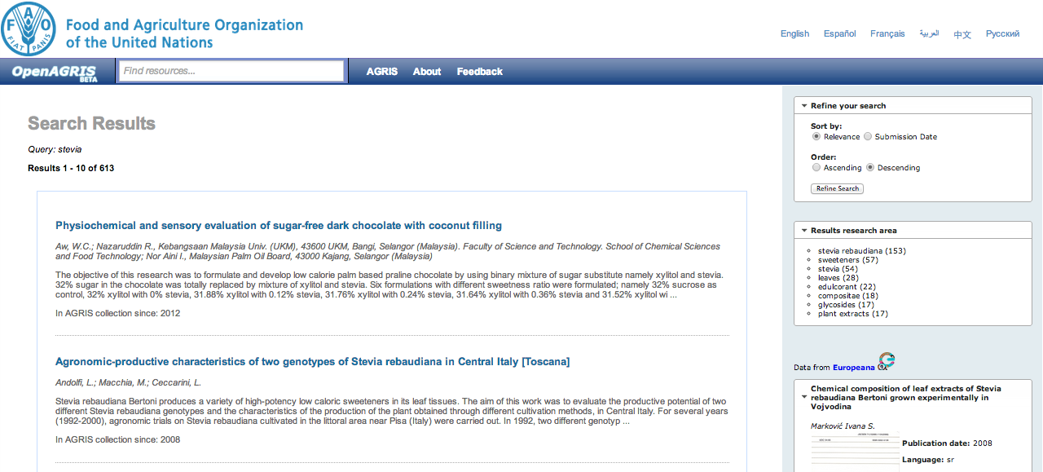
Focus only on agricultural publications

Slide 12
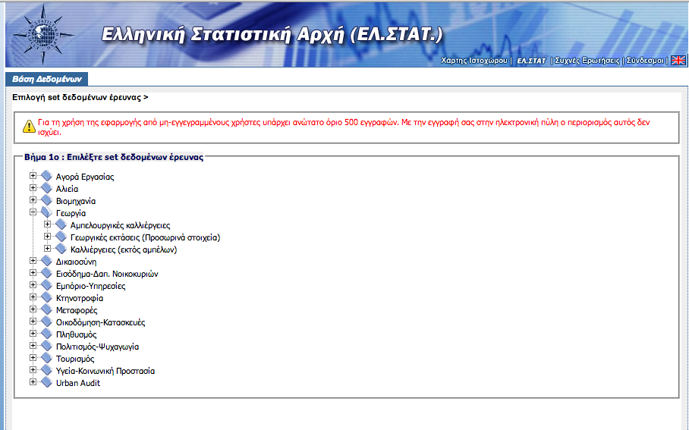
Statistical at national level
Notes:
Statistical Service (http://www.mof.gov.cy/mof/cystat/statistics.nsf/agriculture_51main_gr/agriculture_51main_gr?OpenForm&sub=1&sel=2)

Slide 13
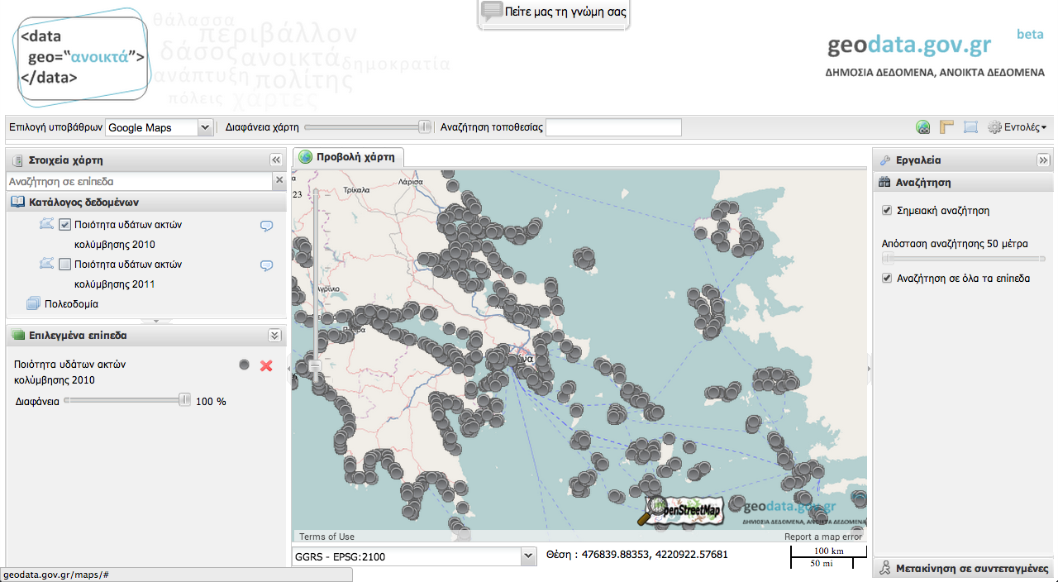
Geo at national level

Slide 14
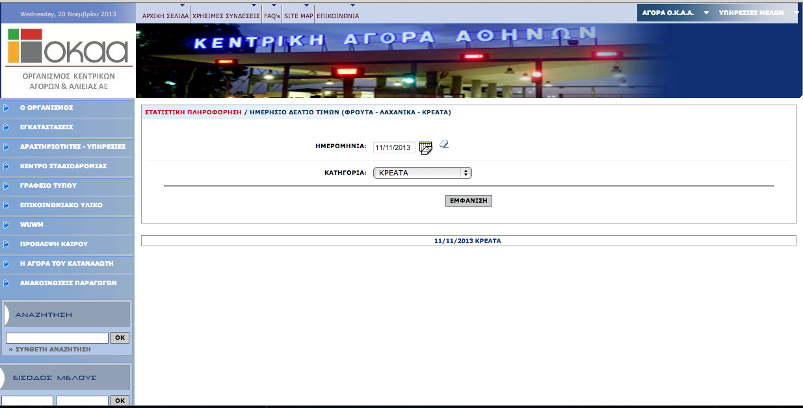
Market prices stream
Problem with the vegetables

Slide 15
Collaboration
Finalize the data components in the wireframe
Check the end points and bring ideas on combining data
JS client for SPARQL
Federated search over sparql end point
feasible?
does it make sense?

