Slide 1

GREEN CITY HACKATHON
The transformers
Michalis Vafopoulos
NTUA, GFOSS & www.publicspending.net

Slide 2
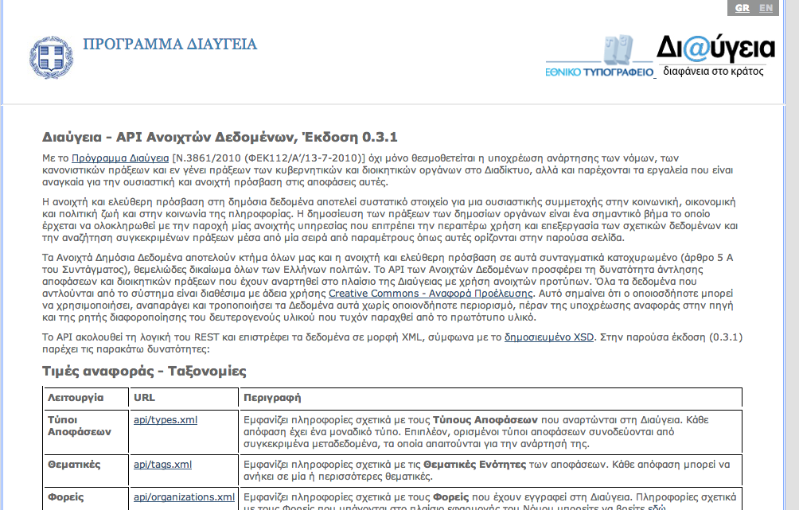

Slide 3
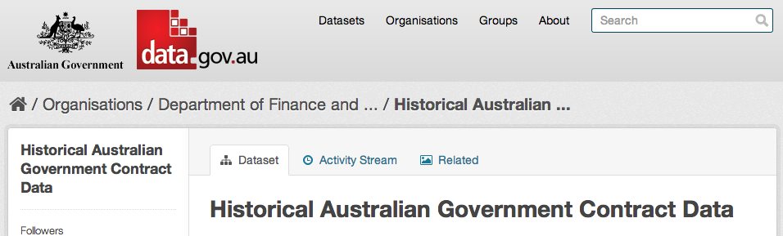
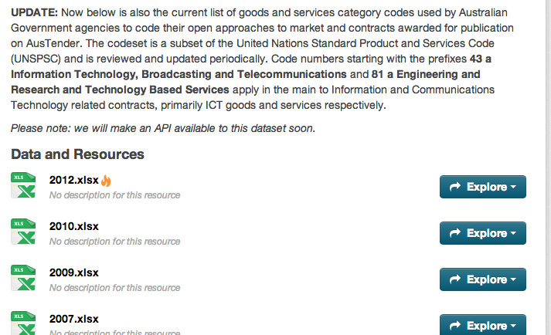

Slide 4
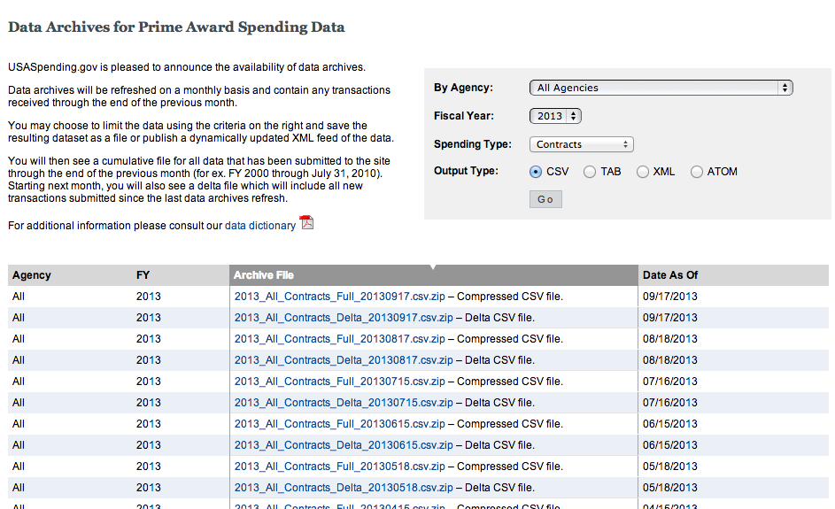

Slide 5
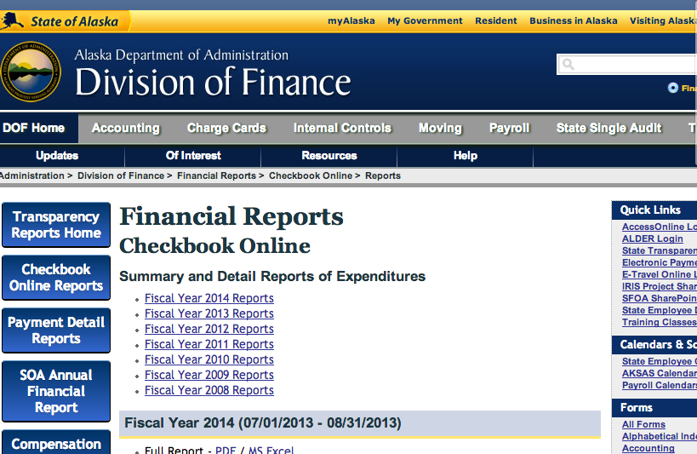

Slide 6
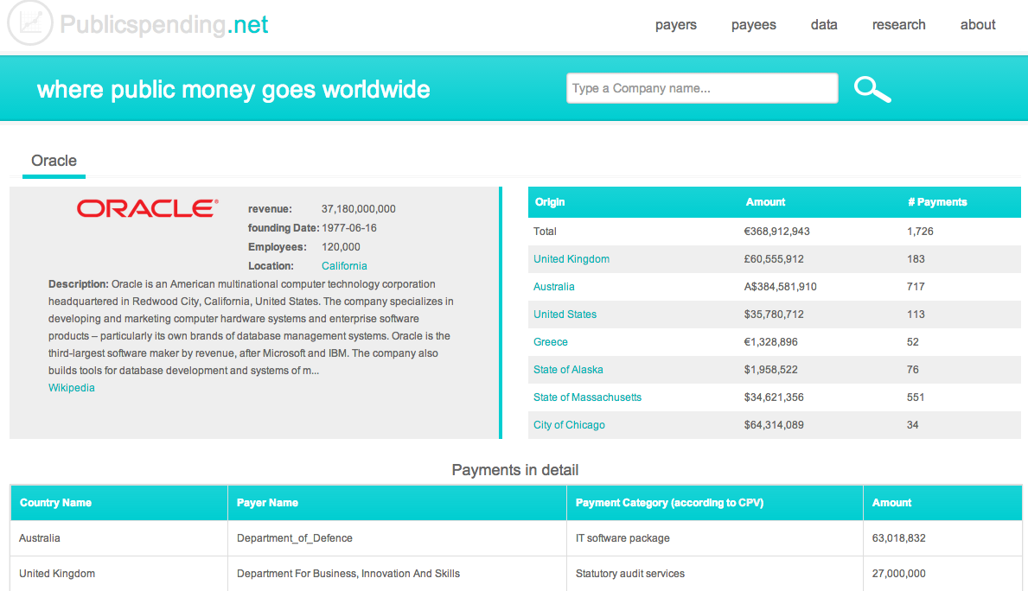

Slide 7







Welcome to the data era

Slide 8
Data: Open, big, linked
Open: access
…everyone to use and republish as she wishes
Big: scale
high volume, velocity and variety
Linked: use
Publish once, use as many times

Slide 9
How is it working?
Linked data in a nutshell
Sources: T. Heath, J. Sequeda, the Web

Slide 10
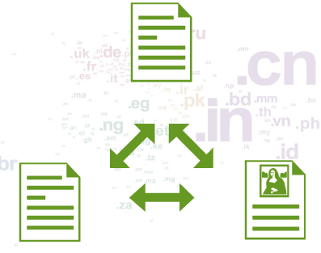
The Web of Documents
Analogy: a global file system
Designed for: human consumption
Primary objects: documents
Links between: documents (or sub-parts of)
Degree of structure in objects: fairly low
Semantics of content and links: implicit-humans
(Tom Heath)
The web = the internet
+ links + documents

Slide 11
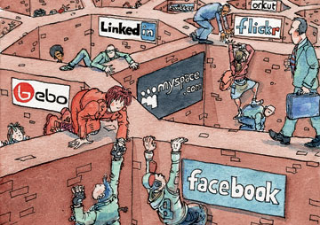
The Web of Documents
Simple, big and unstructured
Organized in Silos
But humans are interested in:
Things, no documents and
these Things might be
in documents or elsewhere

Slide 12
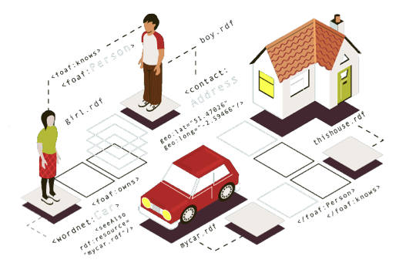
The Web of Data
Analogy: a global filesystem ----> global database
Designed for:human consumption ->machines first-humans later
Primary objects: documents --> things (or descriptions of things)
Links between: documents --> things
Degree of structure in objects: fairly low ---> high
Semantics of content and links: implicit --> explicit
(Tom Heath)

Slide 13
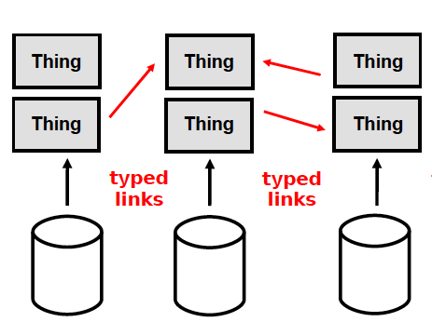
The Web of Data: why?
– encourages reuse
– reduces redundancy
– maximises its (real and potential) inter-connectedness
– enables network effects to add value to data

Slide 14
The Web of Data: how?
Current state on the Web
Relational Databases
APIs
XML
CSV
XLS
Computers can’t consume data because:
Different formats & models
Not inter-connected

Slide 15
The Web of Data: how?
– we need to create a standard way of publishing Data on the Web (like HTML for docs)
This is the Resource Description Framework (RDF)

Slide 16
Resource Description Framework (RDF)
A data model
  A way to model data
  Inspired form Relational databases and Logic
RDF is a triple data model
Labeled Graph (semantic networks)
Subject, Predicate, Object
<Chios> <is part of> <Greece>

Slide 17
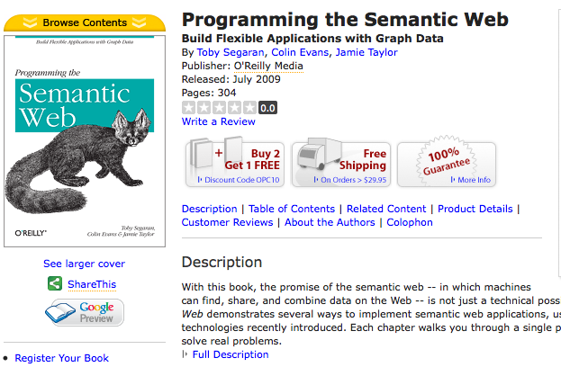
Example: Document on the Web

Slide 18
Databases back up documents
THINGS have PROPERTIES:
A Book as a Title, an author, …
Isbn | Title | Author | PublisherID | ReleasedData
978-0-596-15381-6 | Programming the Semantic Web | Toby Segaran | 1 | July 2009
… | … | … | … | …
PublisherID | PublisherName
1 | O’Reilly Media
… | …
This is a THING:
A book title “Programming the Semantic Web” by Toby Segaran, …

Slide 19
Data representation in RDF
Isbn | Title | Author | PublisherID | ReleasedData
978-0-596-15381-6 | Programming the Semantic Web | Toby Segaran | 1 | July 2009
Programming the Semantic Web
PublisherID | PublisherName
1 | O’Reilly Media
title
book
author
Toby Segaran
isbn
978-0-596-15381-6
publisher
Publisher
name
O’Reilly

Slide 20
Everything on the web is identified by a URI!

Slide 21
link the data to other data
Programming the Semantic Web
title
http://…/isbn978
author
Toby Segaran
isbn
978-0-596-15381-6
publisher
http://…/publisher1
name
O’Reilly

Slide 22
consider the data from Revyu.com
http://…/review1
hasReview
http://…/isbn978
description
reviewer
Awesome Book
http://…/reviewer
name
Juan Sequeda

Slide 23
start to link data
http://review1
hasReview
http://isbn978
Programming the Semantic Web
description
title
hasReviewer
sameAs
Awesome Book
http://isbn978
author
Toby Segaran
http://reviewer
name
isbn
978-0-596-15381-6
Juan Sequeda
publisher
http://publisher1
name
O’Reilly

Slide 24
Juan Sequeda publishes data too
http://juansequeda.com/id
livesIn
http://dbpedia.org/Austin
name
Juan Sequeda

Slide 25
Let’s link more data
http://…/review1
hasReview
http://…/isbn978
description
hasReviewer
Awesome Book
http://…/reviewer
name
sameAs
Juan Sequeda
http://juansequeda.com/id
livesIn
http://dbpedia.org/Austin
name
Juan Sequeda

Slide 26
And more
http://…/review1
hasReview
http://…/isbn978
Programming the Semantic Web
description
title
hasReviewer
sameAs
Awesome Book
http://…/isbn978
author
Toby Segaran
http://…/reviewer
name
isbn
978-0-596-15381-6
sameAs
Juan Sequeda
publisher
http://…/publisher1
name
O’Reilly
http://juansequeda.com/id
livesIn
http://dbpedia.org/Austin
name
Juan Sequeda

Slide 27
Linked data = internet + http + RDF

Slide 28
Linked Data Principles
Use URIs as names for things
Use URIs so that people can look up (dereference) those names.
When someone looks up a URI, provide useful information.
Include links to other URIs so that they can discover more things.

Slide 29
Web as a database
Linked Data makes the web exploitable as ONE GIANT HUGE GLOBAL DATABASE!
Is there any query language like sql?
SPARQL…

Slide 30
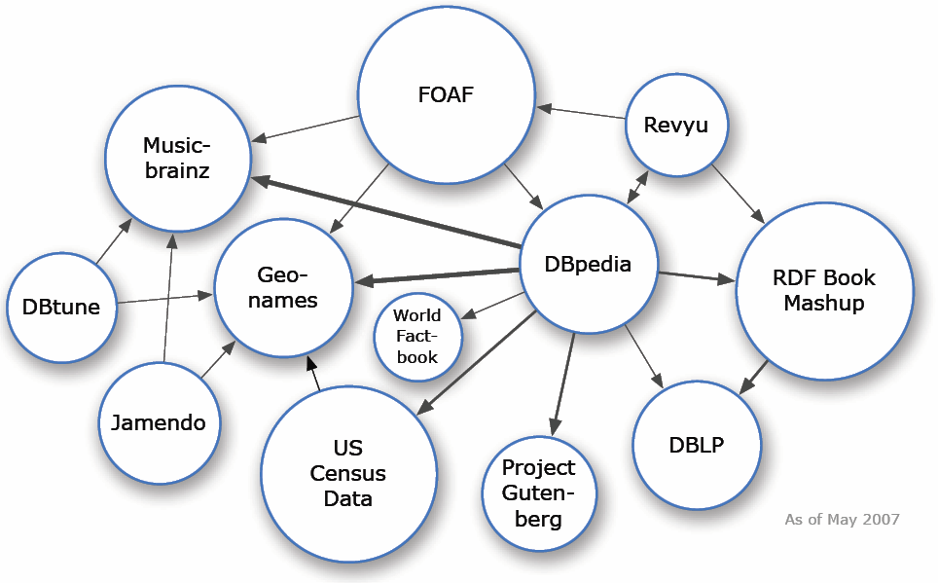
The LOD cloud: May 2007

Slide 31
What is a Linked Data application/service?
Software system that makes use of data on the Web from multiple datasets and that benefits from links between the datasets

Slide 32
Characteristics of Linked Data Applications I
  Consume data that is published on the web following the Linked Data principles: an application should be able to request, retrieve and process the accessed data
  Discover further information by following the links between different data sources

Slide 33
Characteristics of Linked Data Applications II
  Combine the consumed linked data with data from sources (not necessarily Linked Data)
  Expose the combined data back to the web following the Linked Data principles
  Offer value to end-users

Slide 34
the 5 stars of open linked data
★make your stuff available on the Web (whatever format)
★★make it available as structured data (e.g. excel instead of image scan of a table)
★★★non-proprietary format (e.g. csv instead of excel)
★★★★use URLs to identify things, so that people can point at your stuff
★★★★★link your data to other people’s data to provide context
http://lab.linkeddata.deri.ie/2010/star-scheme-by-example/

Slide 35
Ideas for projects
Think of interesting questions
Search for related datasets
And start “playing” with:
Interconnections – links to other datasets
Statistical analysis
Economic/business analysis

Slide 36

Questions??

Slide 37
More examples
Current Employee Names, Salaries, and Position Titles
The Open Database Of The Corporate World
Crime map
NHS efficiency savings: the role of prescribing analytics
where public money goes worldwide

Slide 38
More info
Twitter: @vafopoulos
Vafopoulos@gmail.com
www.Vafopoulos.org
www.publicspending.net
www.Youtube.com/websciencegr

